Slide 1
ENGR 12
Dr. Mandala
Notes:
Down

Slide 2
In your teams
Write a m-script that asks user to enter any string, and find whether the string is a palindrome or not. Use menu command to let user repeat the program.
Use the input to accept user input
Cannot use flip
Print the result including the string the user entered.
EX: ‘You entered: 'A man, a plan, a canal, Panama!’. This is a PALINDROME.’
EX: ‘You entered: ‘Hello’. This is NOT A PALINDROME.’
Example words/phrases to test:
Was it a cat I saw
Rotator
My gym

Slide 3
What command would you use?
To split the figure window into a grid of 3 rows and 3 columns; and add a plot in the 3rd position?
Subplot(3,3,3)
To open a new figure window with title ‘Population by day’?
Figure(‘Name’,’Population by day’)
To close figure window titled ‘Histogram’?
Close(‘Histogram’)

Slide 4
What command would you use
To fit a cubic polynomial curve to the data described by variables x and y?
Polyfit(x,y,3)
To calculate output values of the equation represented by coefficients 0.5 , 1.9 and 2.3; both manually and using built-in MATLAB functions?
0.5*x.^2+1.9*x+2.3
Polyval(polyfit(x,y,3), x)
To resample data between 1 and 7 with 200 datapoints?
Linspace(1,7,200)
Notes:
X=[1 2 3 4 5 6 7]
Y=[1.1 3.0 8.0 21.8 59.4 161.4 438.6]

Slide 5
What command would you use
To fit a cubic spline to the data described by variables x and y?
Spline(x,y)
To calculate output values of the SPLINE equations represented by coefficients [ 0.5, 1.9, 2.3; 0.7, 2.0,1.5; 1.0, 3.3, 2.9 ]
using built-in MATLAB functions?
Ppval(spline(x,y), x)
Notes:
X=[1 2 3 4 5 6 7]
Y=[1.1 3.0 8.0 21.8 59.4 161.4 438.6]

Slide 6
What is the data type of output for
polyval
array
polyfit
array
spline
structure
Ppval
array

Slide 7
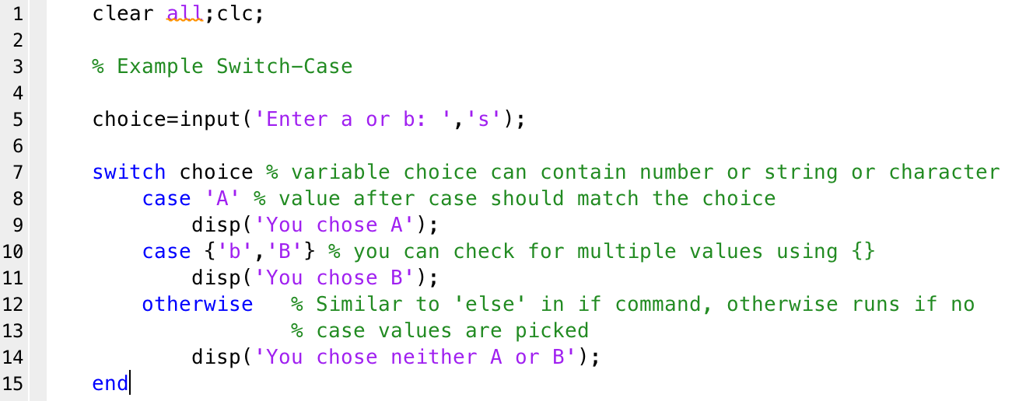
Switch-Case

Slide 8
Download handout

